Slide 1


REIMAGINE’23
Google Cloud Delivery Summit 2023 | May 31 – July 31
Ideathon
Casadona Warriors
#Grow and Disrupt with Infosys Cobalt

Slide 2
Team and Use Case
Team Name | Team Member Name | Mail Id | PU
Casadona Warriors | Sagnik Das | Sagnik.das03@infosys,com | DNA
 | Somdutta Paul | Somdutta.paul@infosys.com | ENG
 | Tania Rana | Tania.rana@infosys.com | IVS
Use Case Name | Protected Healthcare Information (PHI) Data Pipeline for unstructured data management.
Use Case description | Healthcare industry faces a consistent challenge due to magnanimous quantity of unstructured data like prescription, health reports and medical imaging data. However, it lacks a streamlined process through which we can convert both scanned printed documents and handwritten medical instructions. Obscurer would bring a change in the above process by incorporating AI by Google in the data pipeline and helps in conversion of unstructured data to a structured format and stores EHR (Electronic Health Record) information post PII deidentification. This data can be further used by BI tools for visualization and extraction of meaningful insights.

Slide 3
Use Case
Open Use Case - Data Processing Pipeline on Google Cloud
Context
Healthcare industry in the US is $800+ million industry and it is expected to grow even more in the future. More than 80% of the healthcare data is unstructured due to minimal usage of IoT devices. Majority of EHR (Electronic Health Record) are not structured due to the fact that the scanned document are never passed through a powerful OCR (Optical Character Recognition) engine.
Business Relevance
Extracting text from data files and masking PHI information can help hospitals and healthcare processing units to unlock insights from their data and comply with data privacy regulations. Moreover, displaying metadata information and file processing status on a dashboard can help the organizations to monitor and optimize their data pipeline performance and efficiency.
Business Solution
A data pipeline code written in Python/FastAPI (deployed on Google App Engine) can upload data to GCP Cloud Storage and convert them to text format using Google Cloud Document AI. Then it can mask PII information in the text using Google Cloud DLP API and gives the output text files as output. On the other hand, the metadata information and the file processing status can be stored and processed in GCP BigQuery and displayed on a Looker Dashboard for data analysis and reporting.

Slide 5
Benefits of Using Obscurer
Secure Storage
Obscurer uses an highly secure mode of cloud storage where there is minimal risk of data breach. Both the raw processed and deidentified files are stored in the same way inside fine grained access controlled google cloud storage bucket.
PHI (Protected Health Care Information) Redaction
Anonymity is critical while handling crucial health care information as these are highly confidential . But at times it might be required that data scientist and data analyst use these information to get data insights or create data models . For compliance with HIPAA obscurer would provide a seamless deidentified data output for usage by non- medical professionals.
Smart Medicine Name Extraction
As there is a huge amount of unstructured data in the health care industry, there is a need to identify medicine names from a medical report, prescription , doctor slip etc. Obscurer helps in automatic medicine name extraction which can be used for both dashboard creation and for ai model building .
Unified Dashboard Experience
Although obscurer is primarily a data pipeline module however it also provides a looker dashboard which gives a easy analytics view for the data being processed along with the summery .

Slide 6

Solution Architecture
Technical Solution

Slide 7


Design
The Data pipeline code designed as a Python code that uses the FastAPI framework to create a webservice that can accept data files as input and written text files as output. This script also uses the google-document-ai and google-cloud-dlp libraries to interact with Google Cloud Document AI and the Google Cloud DLP API respectively. This script also uses the google-cloud-storage and google-cloud-bigquery libraries to interact with the GCS and GCP BigQuery services respectively.
Architecture
The data pipeline code is deployed on Google Cloud App Engine which are serverless platforms that runs stateless containers or applications on a fully managed environment. Google Cloud App Engine automatically scales up or down the instances based on the demand and only charges for the resources used. The data pipeline code connects to various GCP services such as Cloud Storage, Cloud Document AI, Cloud DLP and BigQuery. The data pipeline code also connects to the Looker dashboard using the BigQuery connector that allows Looker to access and visualize the metadata information and file processing status in BigQuery. The data pipeline code can be triggered periodically or on demand by the data engineer or by an external application. The data analyst and the business user can access the looker dashboard using a web browser and view the metadata information and the file processing status for each files.

Slide 8
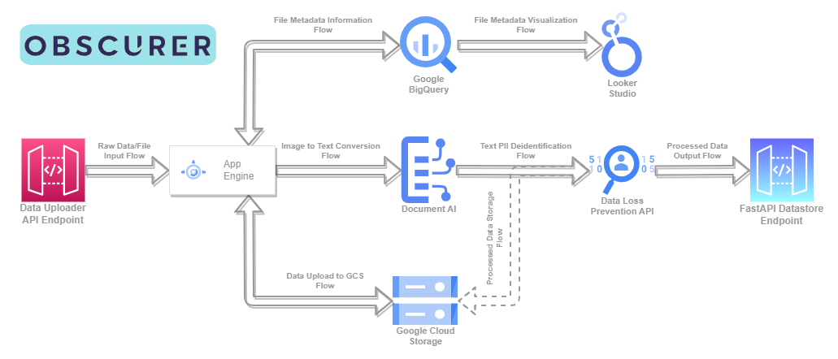
Flow Diagram

Slide 9
Deployment
First, a new project in the Google Cloud Console needs to be created and billing needs to be enabled for it.
Second, Cloud Document AI, Cloud DLP, Cloud Storage and BigQuery APIs needs to be enabled using the cloud storage command line.
Third, a service account for the data pipeline codes needs to be created and granted the appropriate roles to access and use the GCP services.
Fourth, this service account credentials need to be downloaded as a JSON file and stored securely.
Fifth, the data pipeline code repository in GitHub needs to be cloned to a local machine or a Cloud Machine.
Sixth, the code needs to be deployed on App Engine using gcloud app deploy and the service account credentials.
Finally, the data pipeline code can be tested and monitored using the webservice URL and the looker dashboard.
The roles include App Engine Service Admin, Storage Object Admin, Storage Object Creator, Storage Object Viewer, Document AI Administrator Service Agent, DLP API Service Agent, BigQuery Data Editor, BigQuery Job User, BigQuery User.

Slide 10
How did you arrive this solution?
Requirement
Conversion of unstructured data to structured data
Planning
Google App Engine is suitable for deployment of a FastAPI application on cloud
Design
FastAPI provides the user interaction endpoint through Swagger UI
FastAPI application will be deployed and run as PaaS
Implementation
Masking of confidential information
Centralized storage and fast retrieval of secured data
Google Cloud Document AI provides seamless conversion of graphical data and documents
Cloud DLP helps in masking of confidential information
All the backend services are intertwined within the App Engine

Slide 11

Technology Stack
Technical Solution

Slide 12

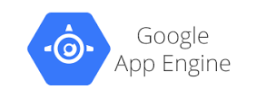

Backend Services
Python
FastAPI
App Engine
Data Pipeline Endpoint
Helps write scripts which integrates all components for this project.
Eases creation of API Endpoint, with quick and simple steps.
Helps contains all FastAPI / Python scripts and runs them on a serverless computing infrastructure.

Slide 13
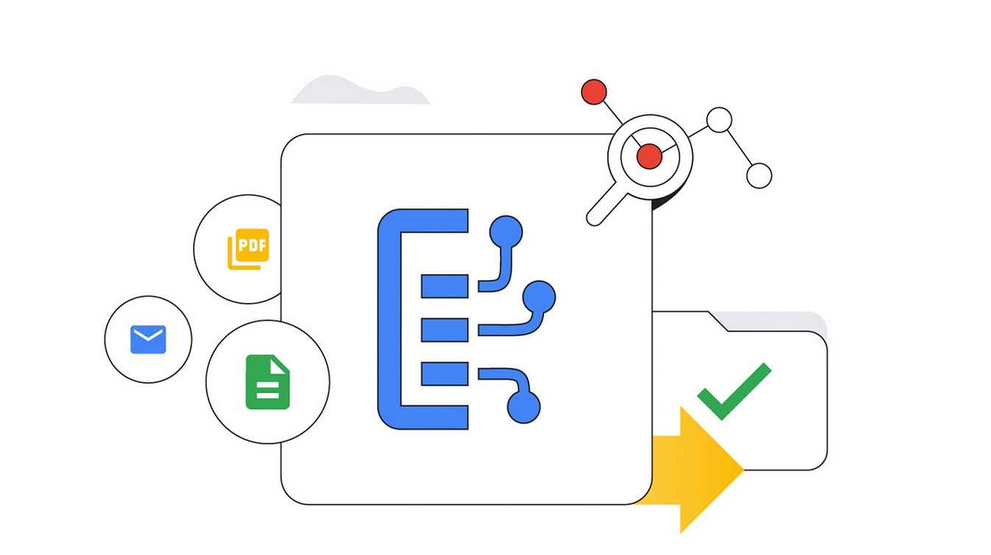
Google Cloud Document AI
Helps convert documents and images to human readable text.
Easy integration with other Google cloud services.
Use your document data to gain new insights about your products and meet customer expectations.
Manage the entire unstructured document lifecycle in one unified solution.

Slide 14
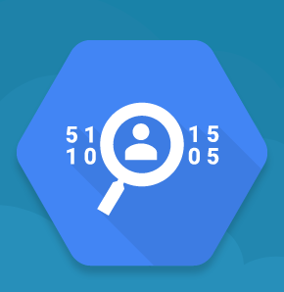
Google Cloud DLP
Reduce data risk with obfuscation and de-identification methods like masking and tokenization.
Seamlessly inspect and transform structured and unstructured data.
Inspect sensitive text and determines where sensitive and high-risk data resides in our projects.

Slide 15
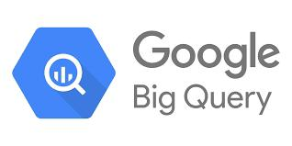
Big Query
BigQuery is a serverless and cost-effective enterprise data warehouse that works across clouds and scales with your data.
Helps in storing metadata information in form of tables.
Helps analyze and report insights from metadata information by using views.

Slide 16

Looker Studio
Looker Studio
Self-service business intelligence with unmatched flexibility for smarter business decisions.
Helps in telling impactful story about metadata information.
Transforming data to business metrics and dimensions with intuitive smart reports.
Creating meaningful, shareable, customizable charts.
Uniting data by connecting to multiple data sources.
Easy connection with Google Big Query

Slide 17
Thank you

